Slide 1

Implementing Cross-Enterprise Document Sharing (XDS) based on Blockchain Technology
Petnathean Julled
Progress 16 Dec. 2019

Slide 2



Explain Current Implementation Steps
Design Overview
XDS Blockchain
Registry Query [ITI-18]
Search
Smart
Contract
Interpreter
Add
Responder
Query Result
Read
Ethereum
Blockchain Ledger
Interpreter
& Simplifier
Register Document Set-b [ITI-42]

Slide 3
Smart Contract
Search
Smart
Contract
Interpreter
Add
Responder
Read
Interpreter
& Simplifier

Slide 4
Smart Contract - Add
Smart Contract
Solidity ‘Struct’
JSON
Publish
To
Blockchain
Add
Assign unique ‘ETH’ Address
Ex. 0xef8ty5h4f5g9f7d4vdfd36g
Each XDS Document will have its unique
ETH Address on Blockchain
XDS META-Data Attributes
Read
Search

Slide 5
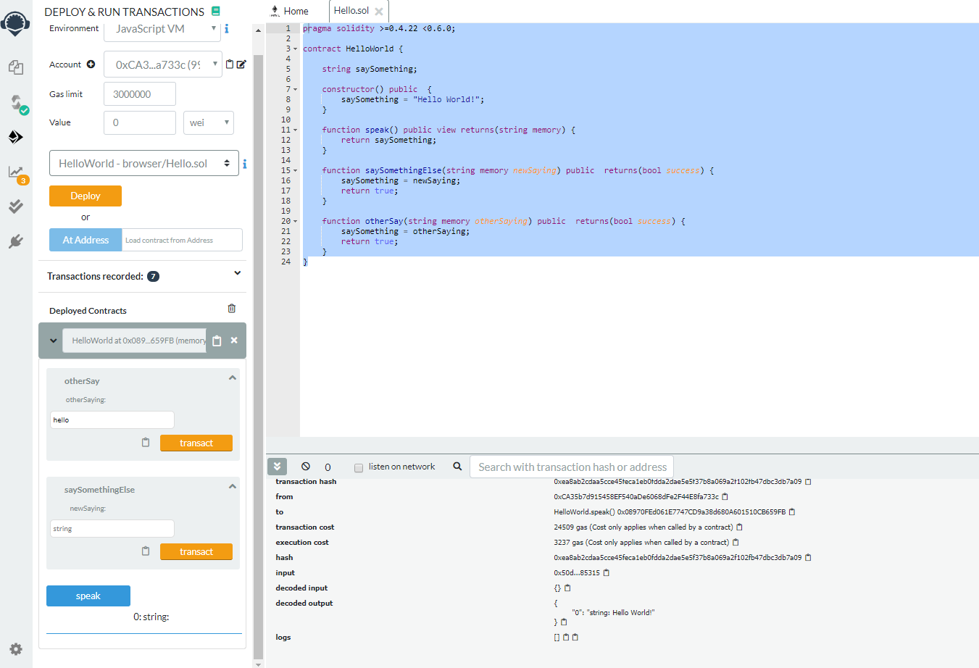
Smart Contract – Add – Coding in Remix IDE
Deploy and Run Transaction Controller
Solidity Code
Console
Smartcontract Simple UI

Slide 6
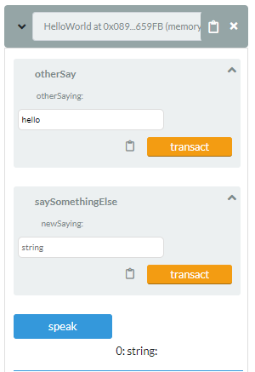
Smart Contract – Add – Coding in Remix IDE
Input Function
Return Function

Slide 7
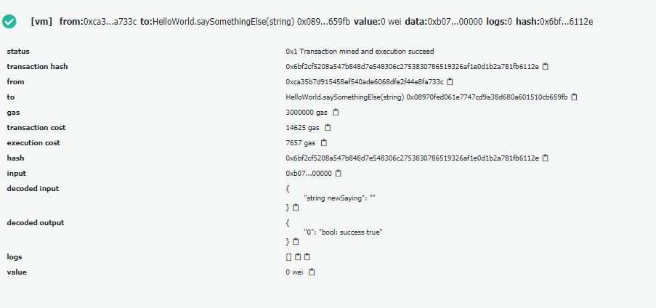
Smart Contract – Add – Coding in Remix IDE
Input Function
Input Value
Each XDS document have its own unique ETH Address

Slide 8
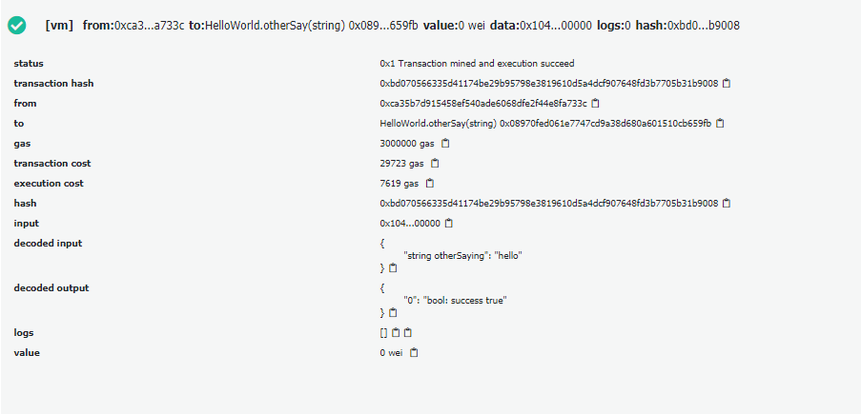
Smart Contract – Add – Coding in Remix IDE
Input Function
Input Value
Each XDS document have its own unique ETH Address
These ETH Address will be remembered by local search program which allow them to be discoverable in Blockchain

Slide 9
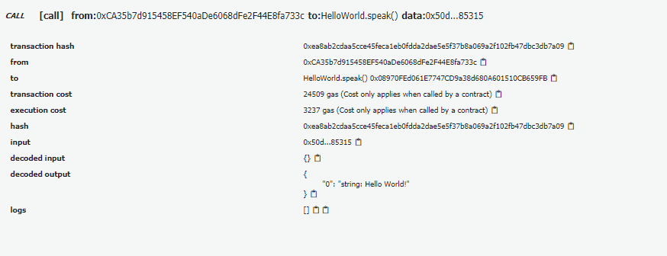
Smart Contract – Add – Coding in Remix IDE
Return Function
Return Value
Each XDS document have its own unique ETH Address
That mean, search program will look into each ETH Address to find for XDS META-Data attributes with matching value to the one provided by search requirement

Slide 10
Smart Contract – Search and Read
Smart Contract
Search
Solidity ‘Struct’
JSON
Search
Requirement
Input
Return All
Matched
Result
Read
Search
Result
Search all ETH Address for matching XDS META-Data Attributes

Slide 11
Task List
Create Javascript program which receive and interpret ITI-42 transaction by convert it into JSON
Create Smartcontract to store XDS META-Data attributes of each document withim Blockchain
Create Web3js program which programmatically deploy and transact Smartcontract with Javascript code
Create Javascript/Web3js search program which look into all ETH Addresses to seek for matching XDS Document within Blockchain
Create Javascript program which allow XDS Registry to communicate with XDS Consumer (Comply to the standard)
Create simple UI for XDS Consumer to demonstrate the query concept

Slide 12
Previous Progress

Slide 13
Design Overview
XDS Blockchain
Registry Query [ITI-18]
Search
Smart
Contract
Interpreter
Add
Responder
Query Result
Read
Ethereum
Blockchain Ledger
Interpreter
& Simplifier
Register Document Set-b [ITI-42]

Slide 14
Sample ITI-42 transaction

Slide 15
Simplified form of metadata attributes retrieved from ITI-42

Slide 16
Interpreter & Simplifier javascript code

Slide 17

Design Overview
XDS Blockchain
Registry Query [ITI-18]
Search
Smart
Contract
Interpreter
Add
Responder
Query Result
Read
Ethereum
Blockchain Ledger
Interpreter
& Simplifier
Register Document Set-b [ITI-42]

Slide 18

Remix IDE for Ethereum Solidity

Slide 19

Remix Interface
Area for Solidity code
Compiler/Validator
Console

Slide 20

Solidity Code
Declare suitable version of compiler (“pragma”)
Declare smartcontract name
Declare initial value of variable saySomething
Declare function
This function return value of variable saySomething to contract issuer
This function replace value of saySomething with issuer specified value

Slide 21
Compiler/Validator
Environment for compiling
-Javascript VM -> Web based compiler with no actual Blockchain
(Simulated Blockchain Environment)
- Web3js -> Web3js instance created by local blockchain
Issuer account on specified environment
Gas Limit which prevent infinity loop error
Wei value represent cost to execute contract
Executed contract
Value specified by issuer to replace value of variable saySomething
using function ‘transact’
Returned value after execute function ‘speak’

Slide 22
Flow chart of this example contract
No
Return “Hello World!”
Function “speak”
Any input?
saySomething = “Hello World!”
Function “transact”
saySomething = <input>
Return <input>
Yes

Slide 23
Flow chart of our initial smart contract will be like this
saySomething
= metadata attributes + ITI-42 transaction
Return value of saySomething =
metadata attributes + ITI-42 transaction
Our initial smartcontract will just store received value in Blockchain without any change
- value of saySomething will inherit from our Javascript interpreter (JSON object)
- The returned value of this contract will be process by our other Javascript to form ITI-18 transaction

